Slide 1
“ REAL TIME AIR QUALITY MONITORING AND ALERTING SYSTEM USING ARDUINO ”
Mini Project
R. Akhil Babu -1NH22EC131
V. Siva Naga Mahendra Reddy -1NH22EC180
Guided By
Ms.babychitra
Senior Assistant Professor
Dept. of ECE
New Horizon College of Engineering, Bengaluru

Slide 2
Contents
Introduction
Literature Review
Existing System
Problem Statement & Objectives
Proposed System
Block Diagram
Hardware & Software Specification
References
Progress Work

Slide 3
Introduction
The rapid degradation of air quality has become a pressing global concern, posing severe threats to human health, environmental sustainability, and economic development. Traditional air quality monitoring methods are often time-consuming, labor-intensive, and provide delayed results. This project aims to design and develop a Real-Time Air Quality Monitoring and Alerting System, leveraging IoT sensors and wireless communication protocols to provide accurate, real-time data and prompt alerts, enabling informed decision-making and mitigating the adverse effects of air pollution.

Slide 4
Literature Review
Title of the paper | Author & Year of Publication | Journal | Volume and Page Number
Design and development of an Real-Time Air Quality Monitoring And Alerting System | Zhao, L., Zhang, X., & Li, Y (2018) | Journal of Environmental Engineering, | 44(3), Peg/No:-250-265.
Low-Cost Sensors for Real-Time Air Quality Monitoring | Liu, H., Chen, J., & Wu, Q (2020) | . Environmental Technology & Innovation | 17(2) Peg/No:-105-118
IoT-Based Solutions for Environmental Monitoring
Patil, S., & Kulkarni, S. (2019).
International Journal of Smart Sensors and Applications,
8(4), Peg/No:- 145-157.
Display Unit for Air Quality Monitoring
Sreedharan.V., Nair, S., & Sharma R
(2020).
Features, Applications, and Public Health Impact. Journal of Environmental Health,
12(2),
Peg/No:- 221-230.
Alerting Mechanisms for Air Quality
Monitoring Systems:
Mishra, P., Singh, R., & Gupta, A.
(2021)
Audio Alerts. Environmental Monitoring and Assessment,
193(7),
Peg/No:-345-358.

Slide 5
Existing System
A real-time air quality monitoring and alerting system is designed to continuously track the levels of various pollutants in the air, providing immediate feedback on air quality. This is crucial for maintaining public health and safety, especially in urban areas where pollution levels can fluctuate rapidly. By implementing this system, users can be promptly alerted to hazardous air conditions, allowing them to take necessary precautions.
Working Principle :-Arduino Uno is the main heart of this project and I have used MQ-135 Air Quality measurement sensor to measure AQI in ppm. So, first MQ-135 sensor will measure the amount of air pollutant in the air and provide the analog output to the A3 pin of the Arduino. Now, Arduino will send instructions to LCD for displaying the value of air quality provided by the MQ-135. Furthermore, to provide the alert to the user, I have set the threshold of 250 ppm in the code. So if measured AQI is more than 250 ppm then led will blink and buzzer will beep to alert the user about air quality

Slide 6
Problem Statement & Objectives
Problem Statement Air pollution is a pressing environmental and public health issue, particularly in urban areas where industrial activities, vehicular emissions, and other pollutants are concentrated. Traditional air quality monitoring systems are often expensive, large, and lack real-time capabilities, making them inaccessible for widespread use. There is a need for a cost-effective, real-time air pollution monitoring system that can provide immediate alerts to help individuals and authorities take prompt action to mitigate the effects of poor air quality.
Objectives:1. Develop an Affordable System: Utilize low-cost components such as the Arduino microcontroller and air quality sensors to create an affordable monitoring system.
2.Real-Time Monitoring: Continuously monitor air quality in real time, detecting pollutants such as CO2, NO2, smoke, and particulate matter.
3.Data Processing and Display: Implement a system to process sensor data and calculate the Air Quality Index (AQI), displaying the results on an LCD screen.
4.Alert Mechanism: Establish visual (LED) and auditory (buzzer) alerts to notify users immediately when air quality exceeds safe limits.
5.User-Friendly Interface: Design an easy-to-understand interface for displaying AQI and pollutant levels, ensuring accessibility for all users

Slide 7
Proposed System
Air Quality Sensors ( MQ135):Detects pollutants like CO2, NO2, smoke, and particulate matter.
Microcontroller (Arduino)Processes sensor data and calculates the Air Quality Index (AQI).
Display Unit (LCD/OLED)Shows real-time AQI and pollutant levels.
Alert MechanismsVisual Alerts: LEDs indicate different levels of air quality.
Auditory Alerts: Buzzers sound when air quality deteriorates.
Breadboard and Jumper Wires: They connect the components together.
Power Supply: This is what supplies the system with power. It can be
USB cable or a battery

Slide 8
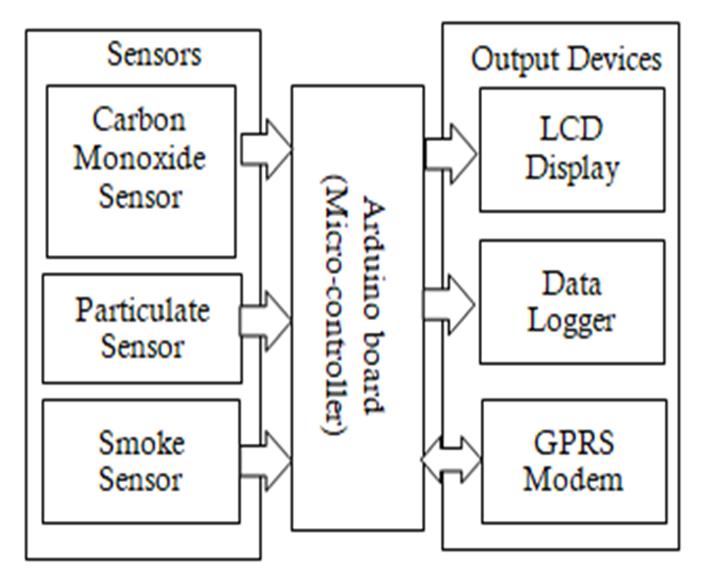
Block Diagram

Slide 9
Hardware & Software Specification
Hardware Specifications:
1.Arduino Uno
2.MQ-135
4.16 × 2 LCD
5.LED
6.Buzzer
7.220 ohm resistor
8.1K ohm resistor
9.Breadboard
10.Transistor BC547 / BC337
11.Connecting wires(jumper wires)
Software Specifications:
1.Arduino IDE (Arduino code)

Slide 10
Progress Work
Components Selected: Arduino Uno, MQ135Sensor,LED, LCD Display, Buzzer, Resistors, Transistor BC547 / BC337, Breadboard, Jumper wires.
Circuit Built: Connected Power Supply and MQ135sensor and LCDs Display to Arduino Uno .
Code Written: Developed and tested code for Real Time Air quality monitoring and alerting system
Testing Done: Verified accuracy and adjusted LCD Display.
Next Steps: Finalize the prototype and document the project.

Slide 11
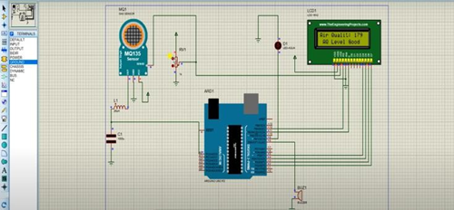
schematic diagram

Slide 12
References
.Real Time Air Quality Monitoring And Alerting System using Arduino and
MQ135 Sensor by Zhao, L., Zhang, X., & Li, Y Journal of Environmental Engineering, 2018
. "Design and Development of Low-Cost Sensors for Real-Time Air Quality Monitoring by Liu, H., Chen, J., & Wu, Q in Environmental Technology & Innovation 2020.
.IoT-Based Solutions for Environmental Monitoring by Patil, S., & Kulkarni, S.in (2019).
.Alerting Mechanisms for Air Quality Monitoring Systems by Mishra, P., Singh, R., & Gupta, A. In (2021)
• https://www.radiolocman.com/review/article.html?di=643721

Slide 13
Thank You

